Slide 1
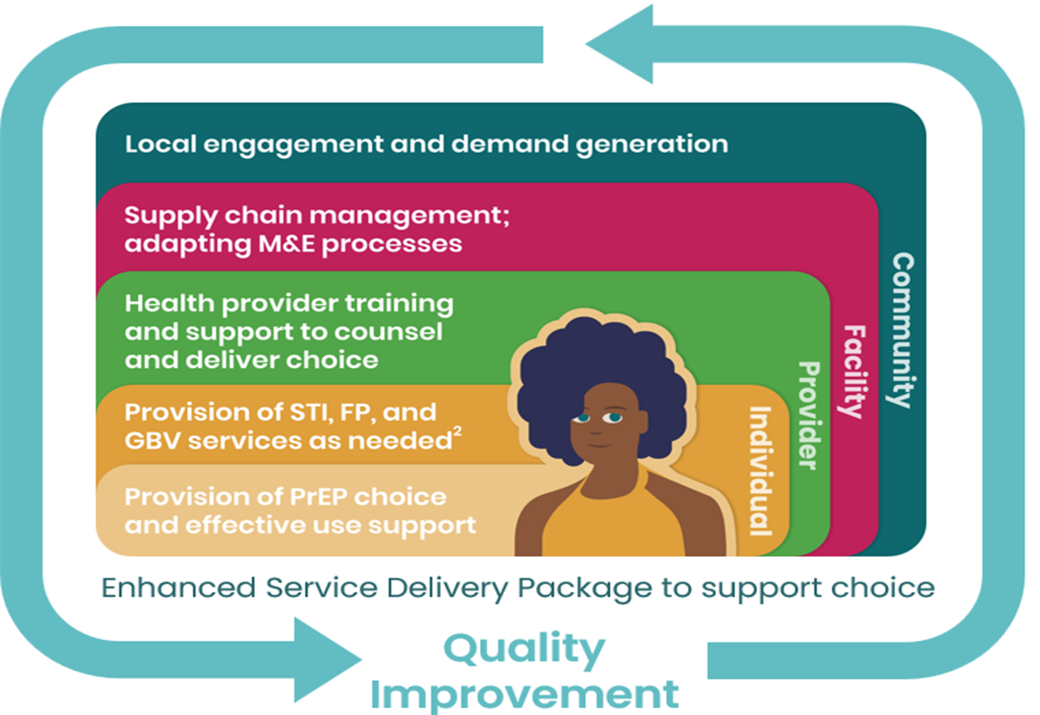
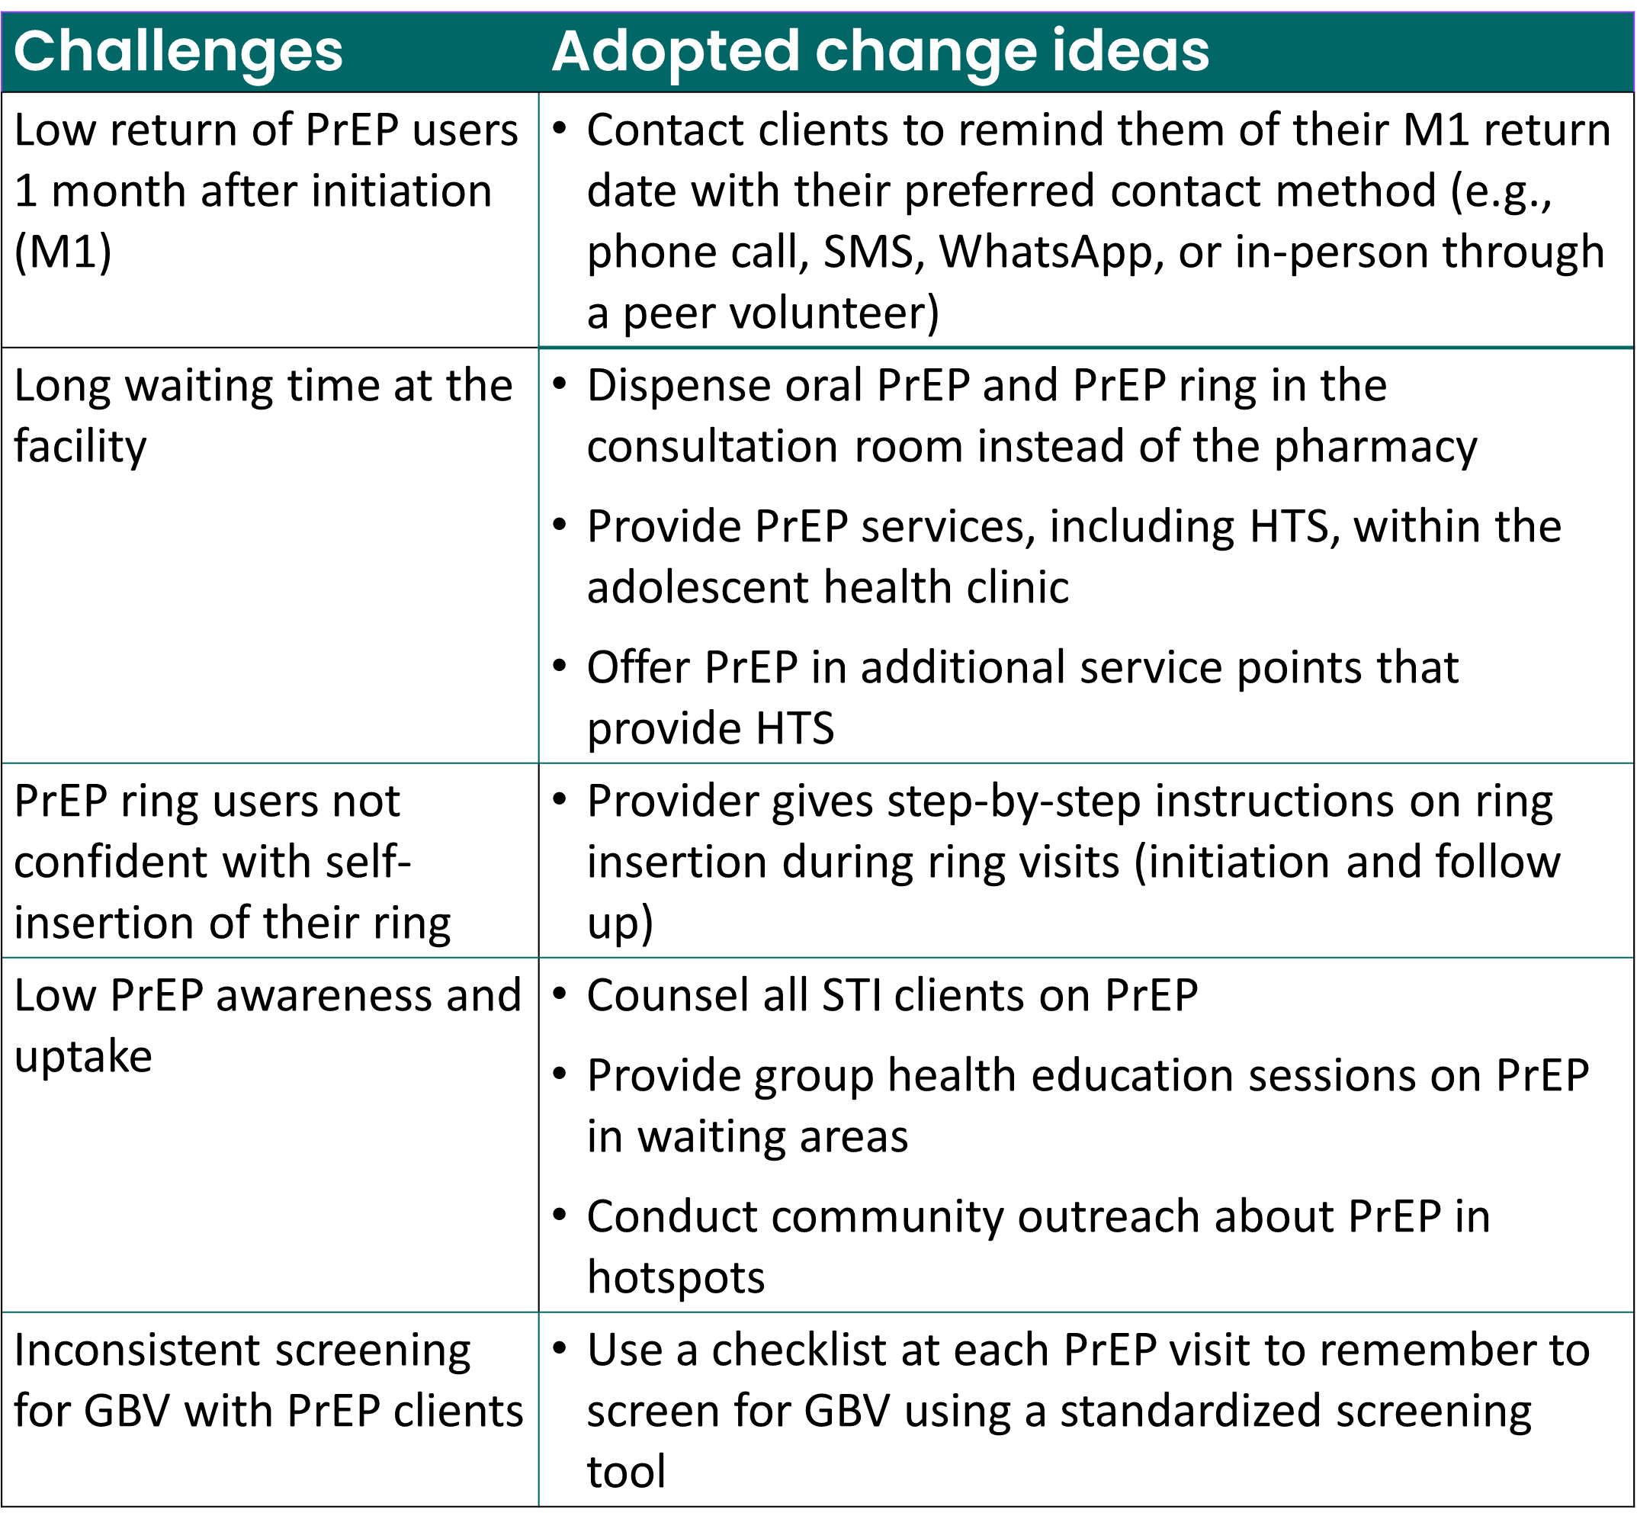
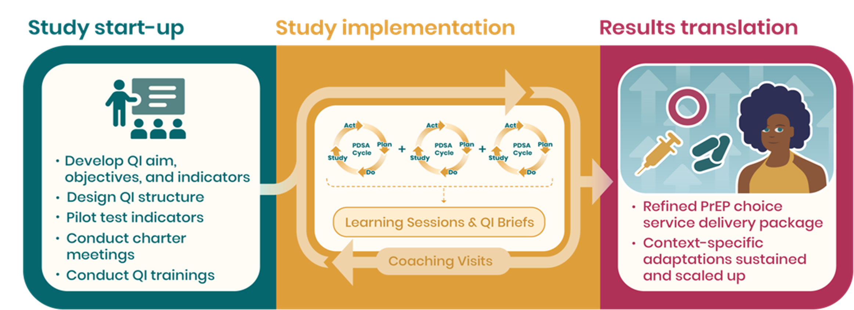

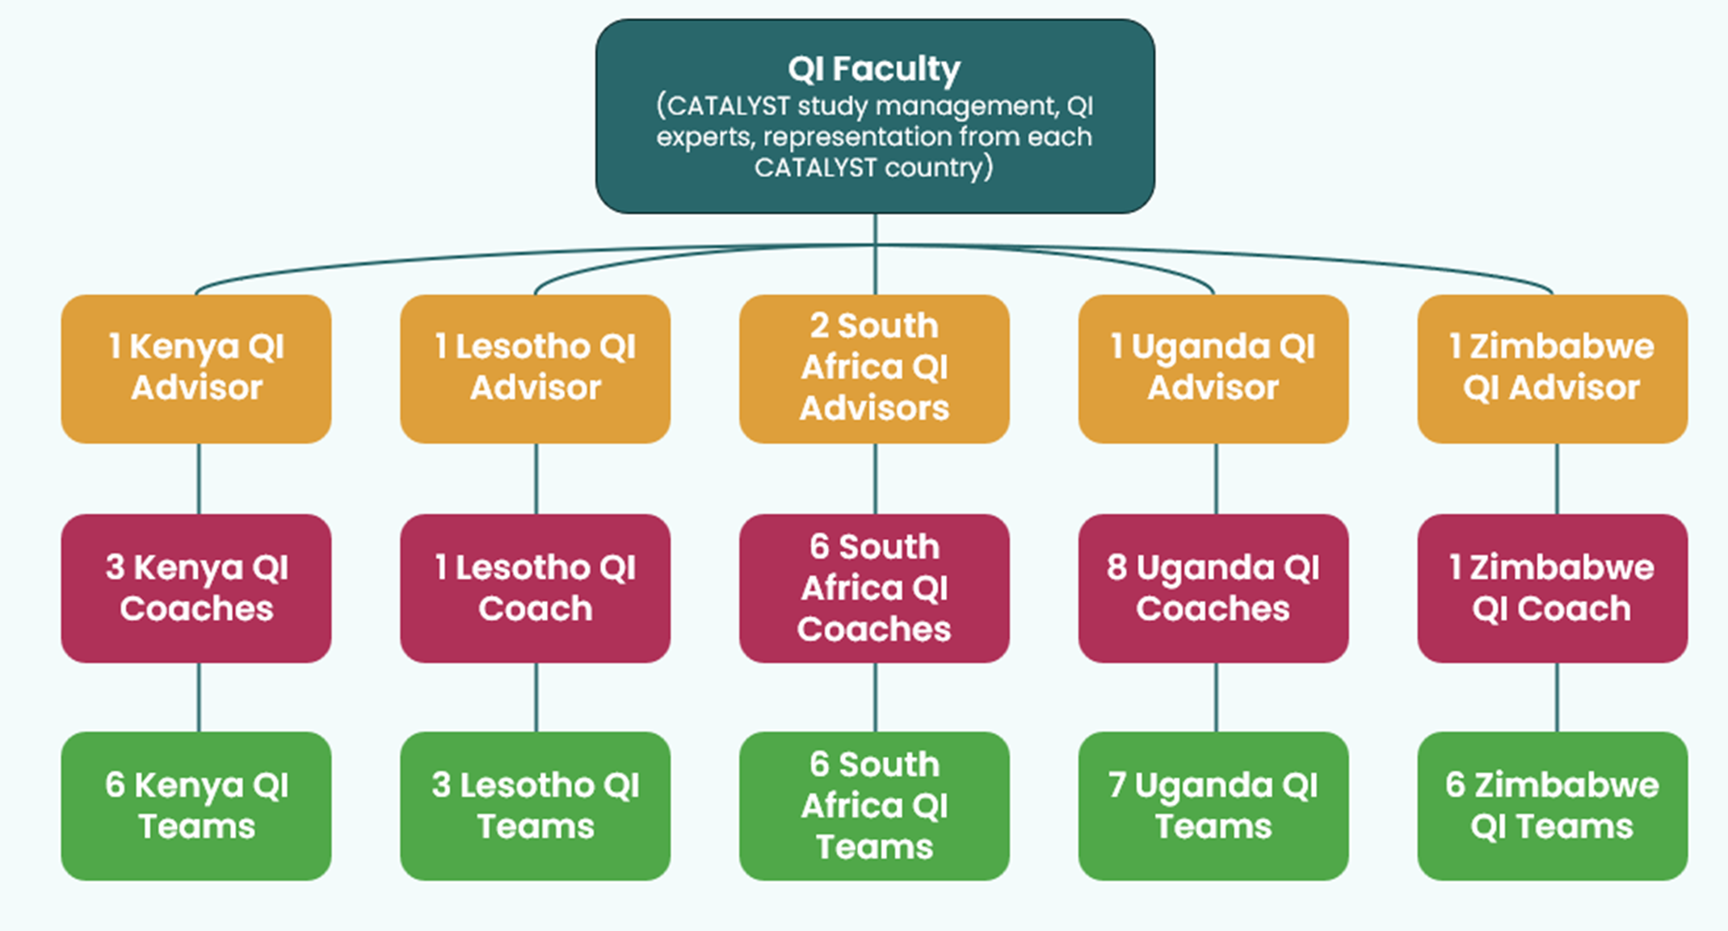


Optimizing the delivery of PrEP choice through a multi-country quality improvement collaborative approach
J. Murungu¹ , E. Irungu² , C. Owino³ , E. Govha⁴ , I. Segawa ⁵, M. Kubutu⁶ , M. Inimah⁷ , M. Otieno³ , N. Ruiru³, N. Rakhmanova⁸ , N.M. Prima⁹ , O. Freda¹⁰ , R.Wilcher ⁸, S. Salinger¹¹ , T. Gwande¹²
1. Pangaea Zimbabwe, Harare, Zimbabwe, 2. Jhpiego, Nairobi, Kenya, 3. LVCT Health, Nairobi, Kenya, 4. Zimbabwe Ministry of Health and Child 7. MOH Kenya, Nairobi, Kenya, 8. FHI 360, Durham, United States, 9. TASO, Kampala, Uganda, 10. Wits RHI, Johannesburg, South Africa, 11. FHI 360, Washington D.C., United SCare, Harare, Zimbabwe, 5. FHI 360, Kampala, Uganda, 6. Jhpiego, Maseru, Lesotho, tates, 12. Jhpiego, Windhoek, Namibia
Background
The PEPFAR/USAID-supported CATALYST study is assessing the implementation of an enhanced service delivery package offering oral PrEP, PrEP ring, and CAB PrEP to women in public health facilities in Kenya, Lesotho, South Africa, Uganda, and Zimbabwe. A multi-country quality improvement collaborative (QIC) is nested in the CATALYST study to refine and contextualize the enhanced service delivery package to the diversity of participating sites. To improve the quality of PrEP service delivery, PrEP outcomes, and client experience, the QIC iteratively assesses performance, introduces context-specific adaptations, and promotes learning across all sites.
Methods
Directed by a cross-country QIC faculty, key stakeholders in each country have adopted a QI charter outlining the aim, objectives, and measurement system of the QIC. Core objectives are increasing informed choice for PrEP, improving PrEP continuation, and fostering positive client experiences through a multitude of indicators (e.g., waiting time, privacy, respectful treatment by providers, and more). Multidisciplinary QI teams from each CATALYST facility are trained in QI methods, and QI coaches support the teams to identify service delivery gaps and begin testing change ideas using Plan-Do-Study-Act (PDSA) cycles. Performance is measured through weekly and monthly run charts, and testing change ideas is documented in coaching reports. In-country learning sessions and cross-country PrEP exchange sessions are held bi-annually to exchange experiences across sites and countries, identify solutions to common challenges, and plan for subsequent action periods. Bi-annual QI briefs serve as a data source for the CATALYST process evaluation, and several cross-country learning sessions are a forum for site teams from across all CATALYST countries to learn from one another.
Results
Stakeholder engagement, including with Ministries of Health, implementing partners and PrEP users, during the development of the QI charter was critical for buy-in and building motivation to implement the multi-country QIC. QI teams require consistent in-person and virtual QI coaching to stay on track with testing change ideas and documenting PDSA cycles. QI change ideas have focused mainly on redesigning client flow, improving access to PrEP through multiple clinic entry points, enhancing PrEP literacy through group health education prior to individual counseling, and creating appointment reminder systems to sustain engagement of PrEP clients. QI teams in the participating facilities have embraced the QIC as a tool for refining the service delivery package and improving PrEP services overall but integrating QI refresher trainings into coaching visits and holding frequent learning sessions are needed to help teams master QI methodology.
Conclusion
The multi-country QIC fosters collaboration, innovation, and shared learning towards the development of a contextualized and scalable Enhanced Service Delivery Package for PrEP choice. Quality improvement is a promising strategy for adapting and improving system performance to deliver multiple PrEP methods with a focus on making informed choice.

