Slide 1
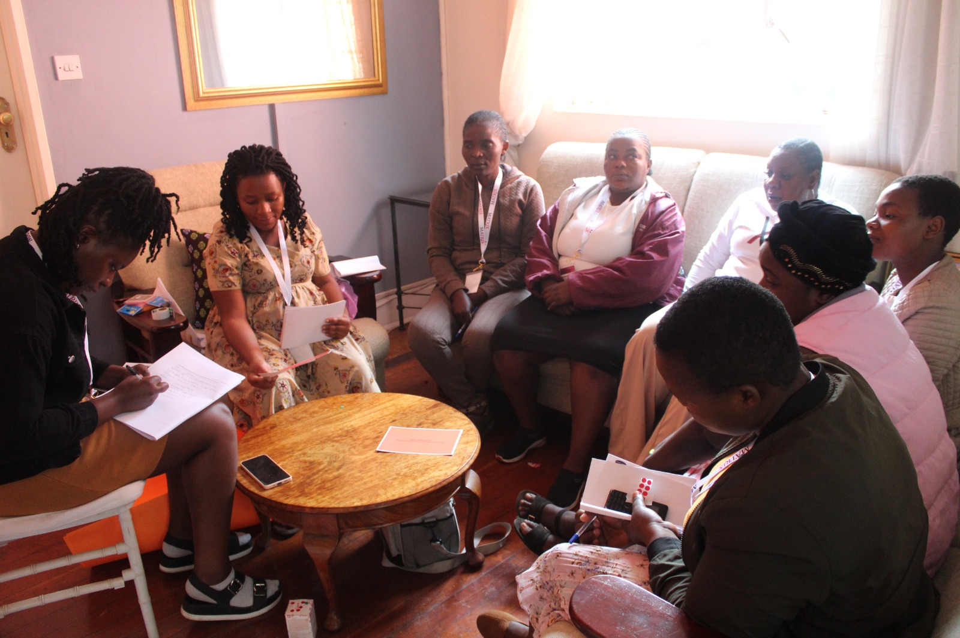
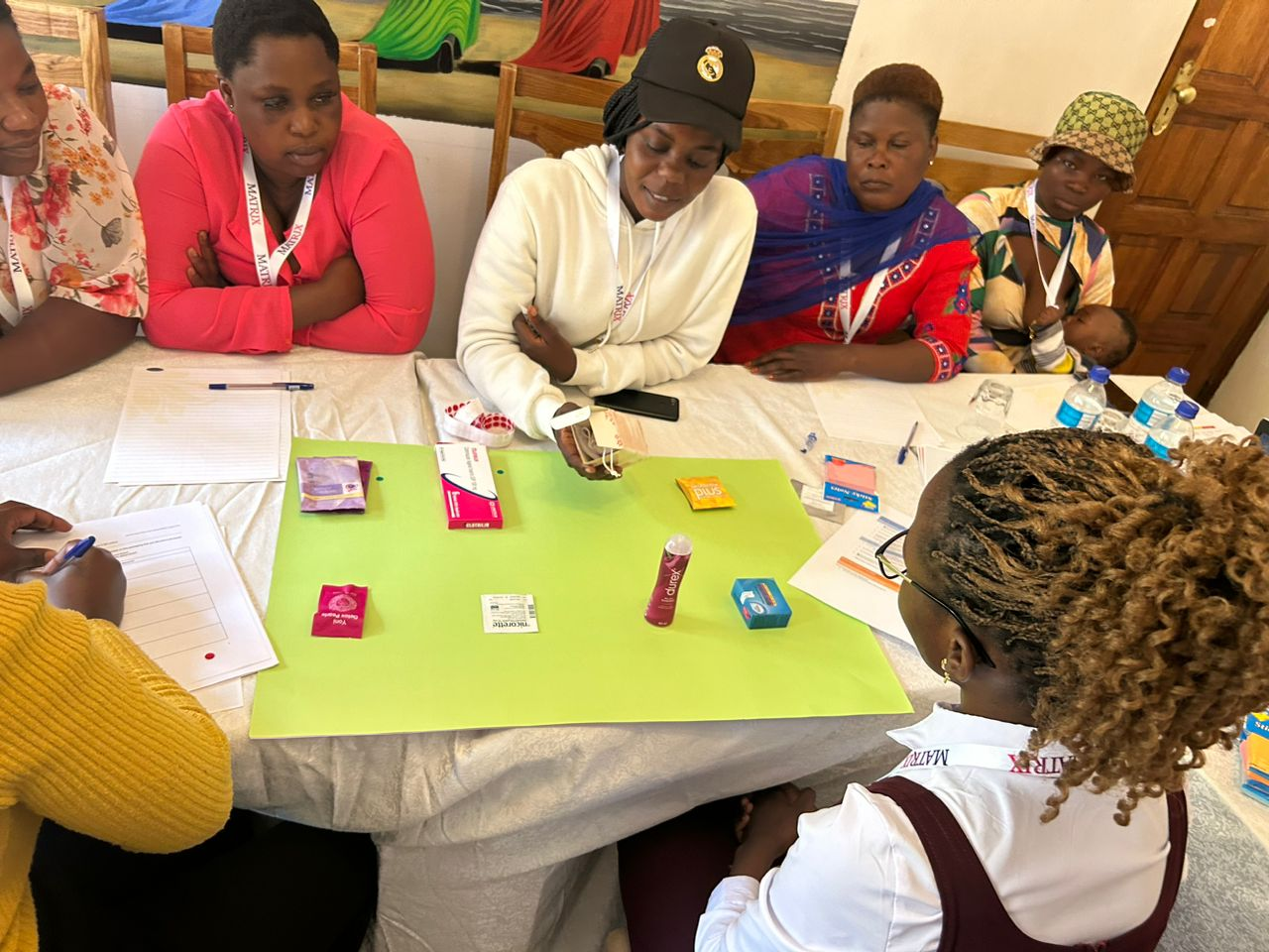
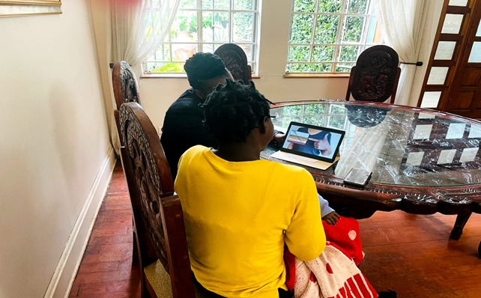
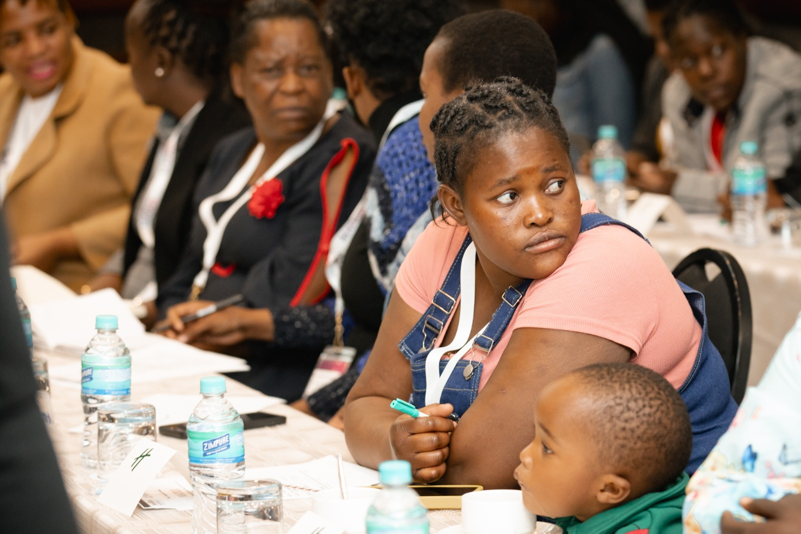
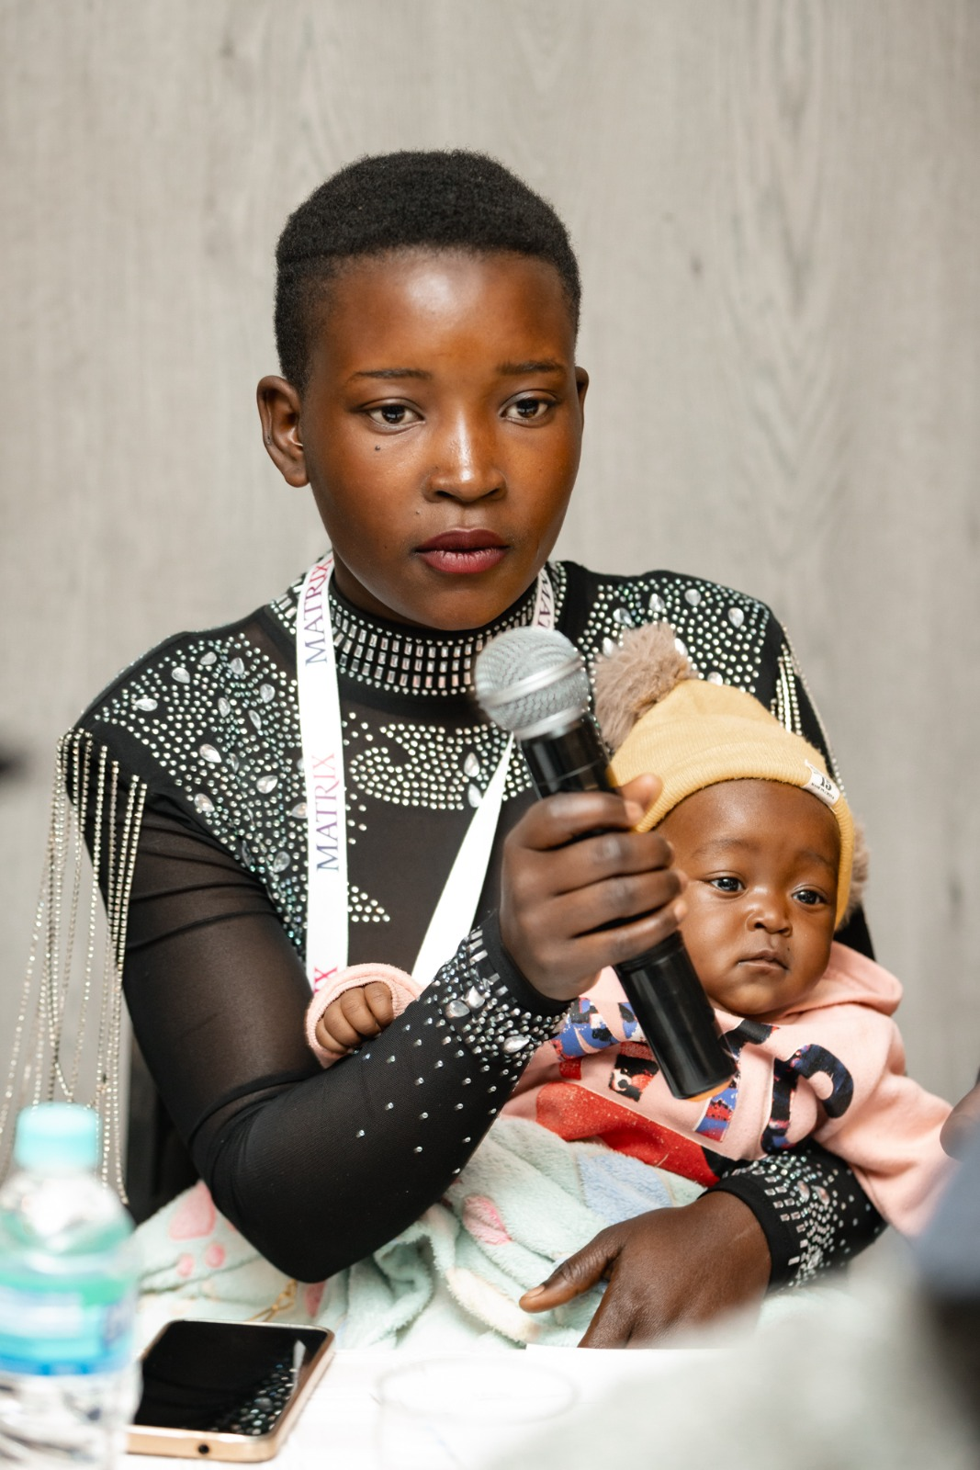


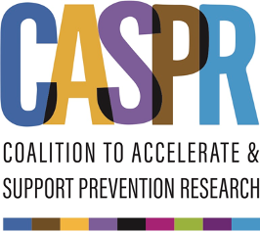



“I wanted to fall pregnant and stay on study product”: Experiences of women who became pregnant during HIV prevention trials and were discontinued from study product in Zimbabwe
---
Authors: Definate Nhamo¹, Cleopatra Mpaso¹, Imelda Mahaka¹ Natalie Eley², Lara Lorenzetti²
Affiliation: 1: Pangaea Zimbabwe, Harare, Zimbabwe 2: FHI360, USA
Background
Findings
Women spend about ten years of their lives pregnant or breastfeeding, a period during which they face an increased risk of contracting HIV due to biological and social factors. Despite this heightened vulnerability, pregnancy is often an exclusionary criterion in biomedical clinical trials. This measure aims to protect both the mother and the fetus from potential side effects of experimental drugs but is often set without consulting women about their preferences. Growing advocacy now calls for the inclusion of pregnant and breastfeeding women in research to ensure access to safe and effective HIV prevention options. This study explored the experiences of women in Zimbabwe who discontinued HIV prevention study products due to pregnancy to inform more inclusive research practices.
Most women wanted to continue the trial product, as it gave them peace of mind knowing they were protected from HIV. They felt continuing on the product after becoming pregnant would have allowed them to contribute to science in women’s health. Some believed the study missed an opportunity to understand the product’s effects on pregnant women and their unborn babies. However, some women supported discontinuation, fearing unknown side effects on their unborn child, as the product was still under study. A few noted spousal pressure to become pregnant despite the study discouraging pregnancy while on the product. Additionally, women valued having adequate knowledge to guide their decision-making..
Methods
Twelve in-depth interviews were conducted with young women in Zimbabwe who became pregnant and discontinued study products in the MTN 034 and HPTN 084 HIV prevention trials. Participants were purposively selected to capture diverse experiences. Interviews explored their feelings about discontinuing the product, understanding of risks and benefits, and perspectives on inclusion in future research. Data were collected in private settings, audio-recorded, transcribed, and thematically analyzed..
Conclusion
Future studies should prioritize pregnant women's right to clear, accurate information on study product risks and benefits, enabling informed choices. Trials must provide direct access to healthcare professionals, user-friendly materials, and trained staff to support participants' decisions. Including pregnant women in research enhances both participant autonomy and the safety and effectiveness of HIV prevention methods..
This work was supported by the Coalition to Accelerate and Support Prevention Research (CASPR), made possible by the generous support of the American people through the US President’s Emergency Plan for AIDS Relief (PEPFAR) and the US Agency for International Development (USAID). The contents do not necessarily reflect the views of PEPFAR, USAID or the United States Government.

