Slide 1
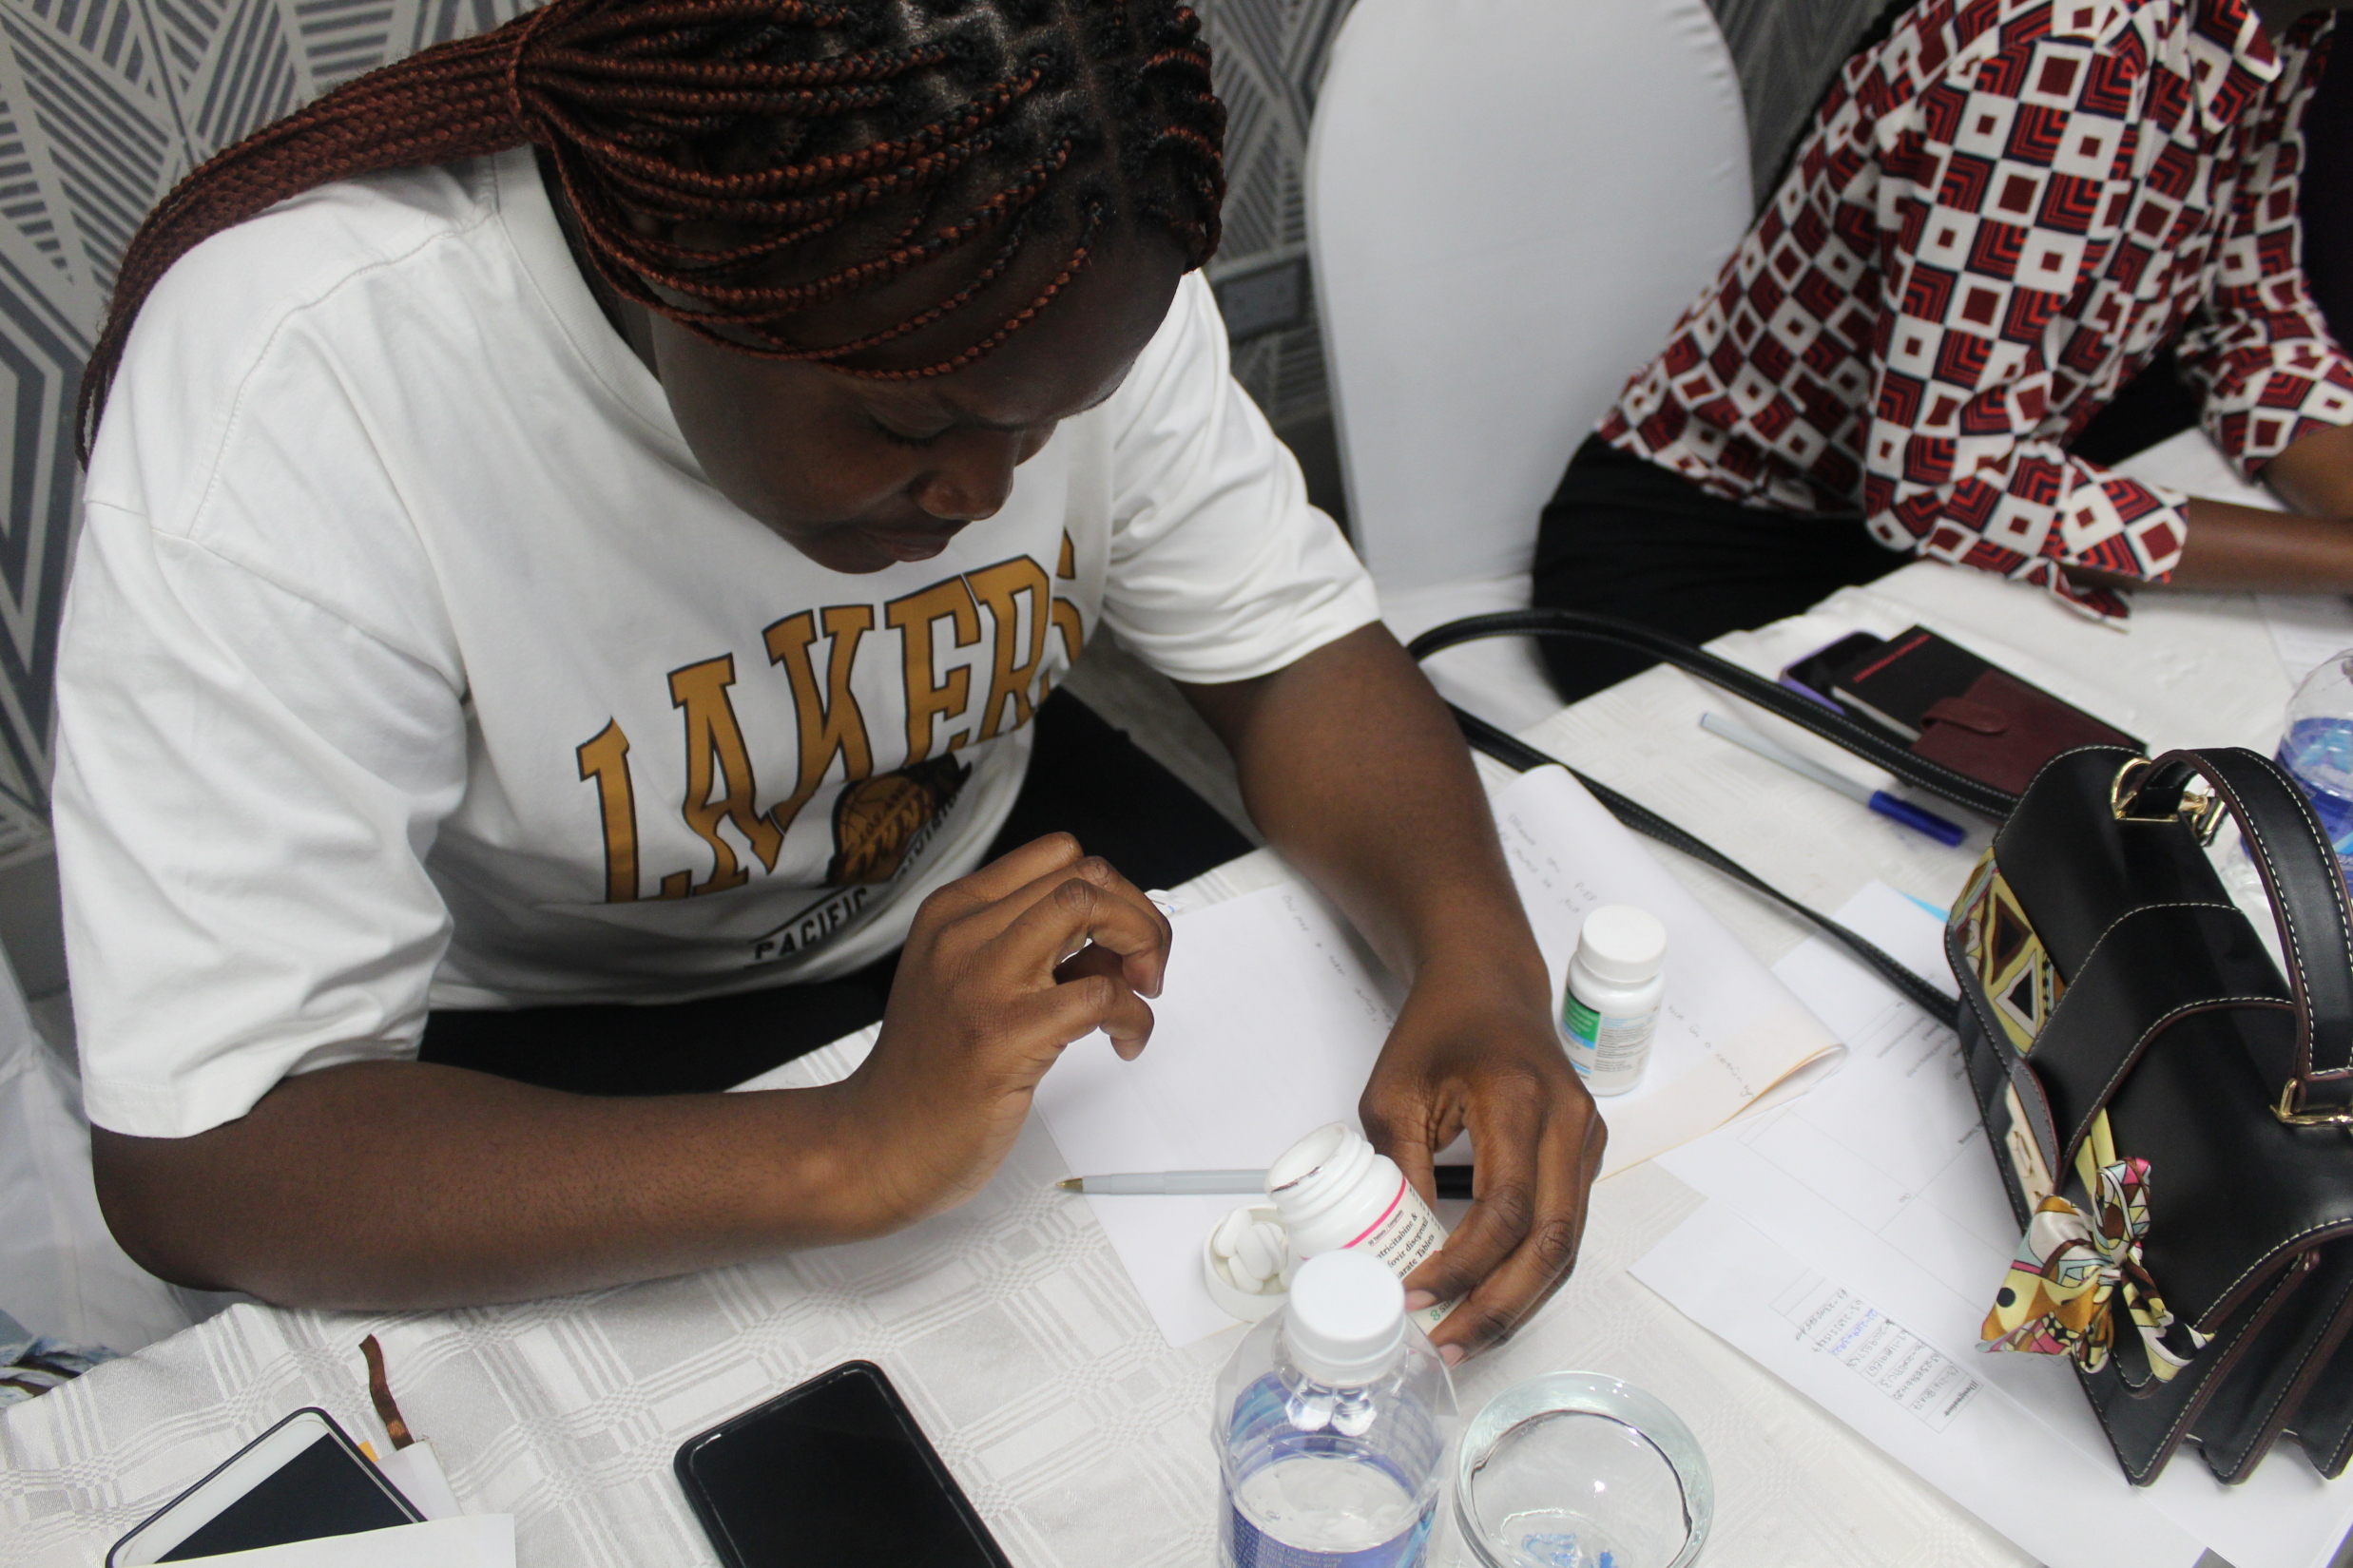
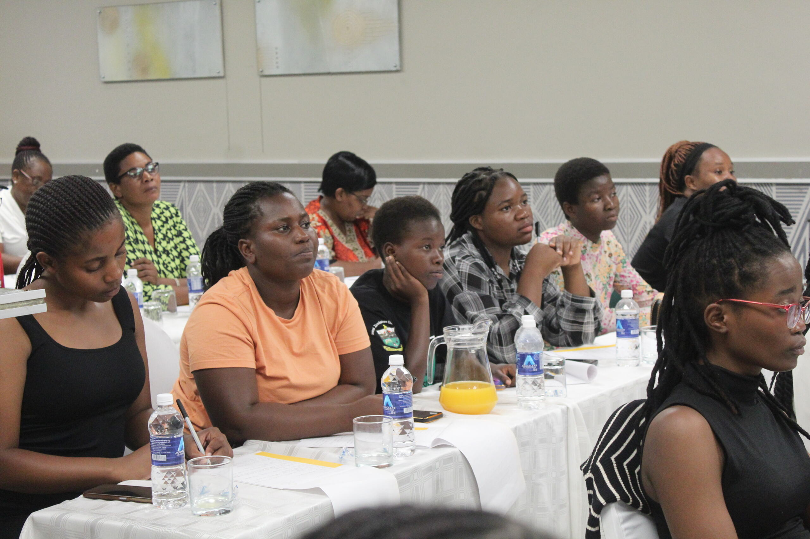
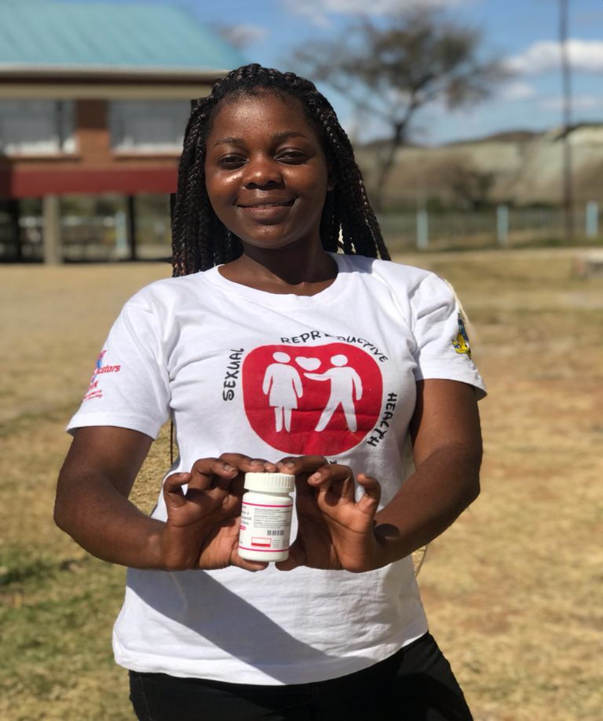
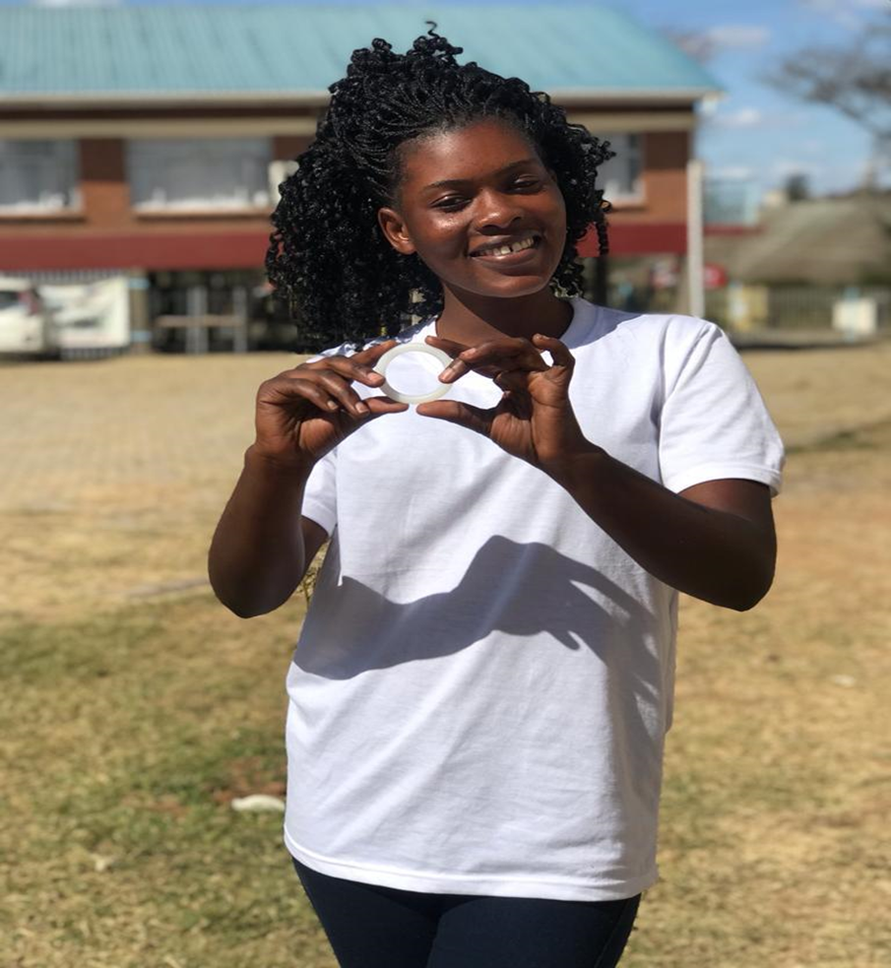
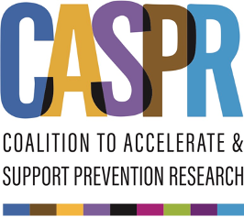

HIVE MODEL
Creating safe spaces to disseminate HIV Prevention Information to AGYW
Pangaea Zimbabwe (PZ)
Description of model
What problem are we trying to solve?
Term “Hive” derived from the analogy of beehive; in structure and function
Consists of 12 young women led by two hive leaders who facilitate meetings and provide relevant information to hive members
Weekly meetings held in their preferred safe spaces; lasting about an hour
Enables open sharing of HIV prevention and sensitive SRH issues affecting them at a personal level, in an environment that is accommodative and non-judgmental.
Model used in seven tertiary institutions by 35 young women
How we work effectively with adolescents and young people
Continuous Learning and Improvement: a WhatsApp group.
Tailormade content – simplified language and materials
Youth Participation and Engagement: allowing young people to lead and participate in regional advocacy platforms eg BHPF during ICASA.
Mentorship and Guidance: working hand in hand with college authorities to sustain the values and practices of Champions.
Holistic Support: referrals to other service providers/ projects such as campus clinics, MOSAIC, and PSI.
Innovative and effective activities implemented
Dialogues- Focus on issues affecting their access to HIV prevention and SRH issues
Advocacy Interface meetings- students and college authorities to find solutions for persisting gaps
Limitations experienced by AGYW when accessing HIV prevention services and information.
Large pool of adolescents and young people at high risk of HIV, STIs, and unintended pregnancy in tertiary institutions
Our Aim
Expand access to HIV prevention options among AGYW in tertiary institutions
Targeting these key stakeholders to facilitate change: Parliament of Zimbabwe, Ministry of Health and Child Care, Ministry of Higher and Tertiary Education and the National AIDS Council and CSOs.
Lessons Learnt
Peer-driven initiatives identify the root causes of limited use of HIV prevention methods in tertiary institutions which can improve tertiary institution HIV prevention service delivery.
Working with college authorities and existing structures helps to garner support for the campus initiatives.
Challenges
Limited number of trained HIV prevention Champions to reach out to all the students in tertiary institutions.
Tertiary institution systems that limit info dissemination and access to HIV prevention products
Outcomes
Plans for Sustainability
An increase in the number of students reporting increased knowledge of how prep works and where it can be accessed.
An increase in the number of tertiary institutions offering oral prep. From 2 at the beginning of the project to 7 now.
HIV prevention Champions from 7 institutions who have been receiving ongoing mentorship and support from PZ.
To ensure a critical mass we also mobilize AGYW who are not part of the hives, through a peer support model that allows widespread dissemination of HIV prevention and SRH information in large groupings through discussions and presentations by champions.
Diversify funding sources beyond grants by establishing partnerships with government agencies and clinics to ensure continuity.
Training of health care workers on KP-friendly services- to equip them to continue offering these vital services

