Slide 1


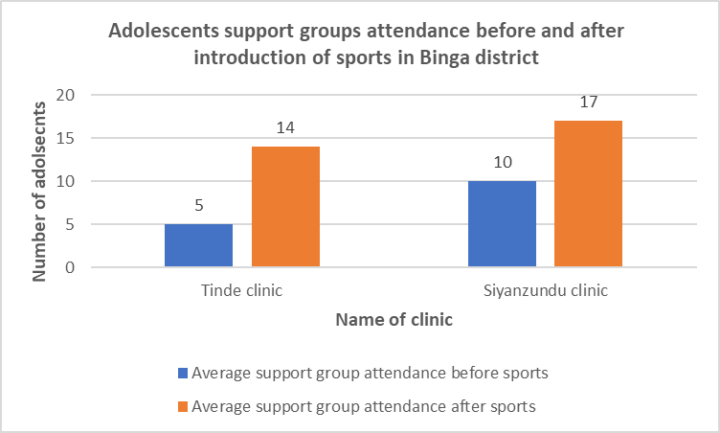
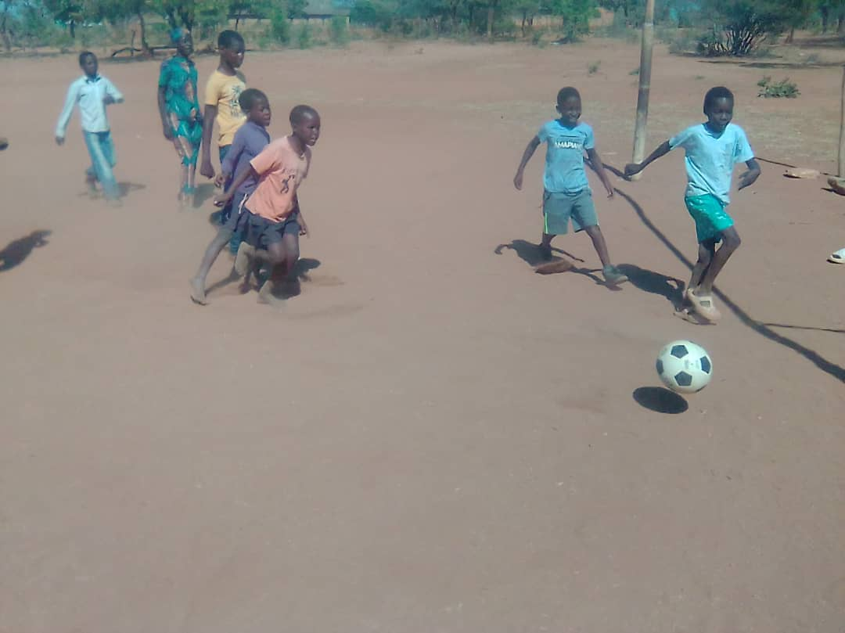
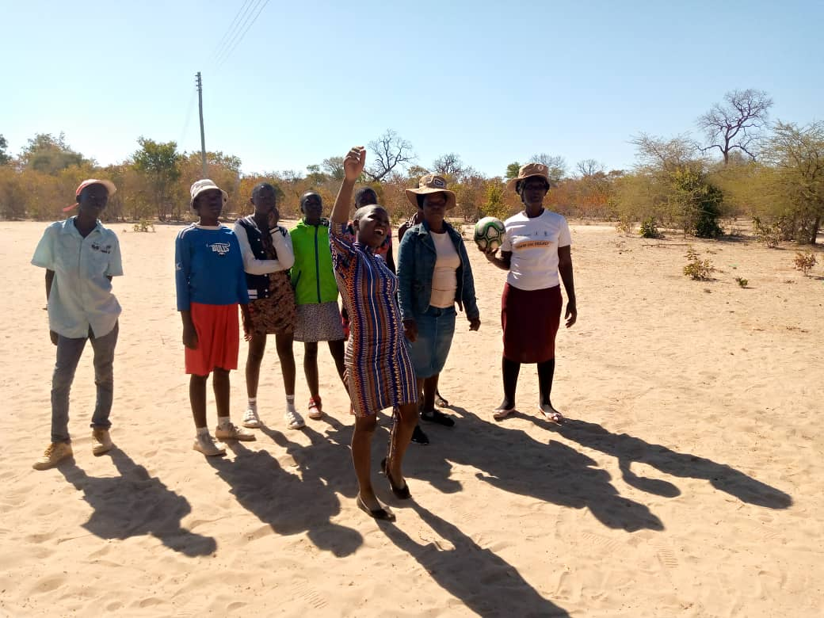
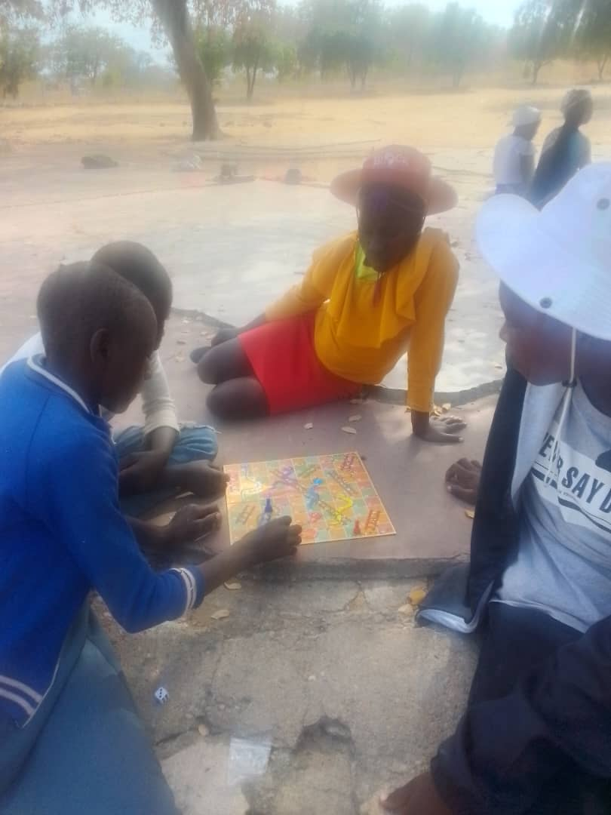


POSTER NUMBER 168
Improving the participation and attendance in support groups by adolescents living with HIV through provision of sports in 2 clinics in Binga district, Zimbabwe
Enock Musungwini¹, Joseph Murungu,² Mmeli Moyo³ Latelang Ndlovu⁴
Programme Manager, Pangaea Zimbabwe – Wild4Life health program.
Senior Technical Advisor, Pangaea Zimbabwe
Community Support Officer, Pangaea Zimbabwe – Wild4Life Health program
Program Director, Pangaea Zimbabewe – Wild4Life Health program
Correspondence: Email: emusungwini@pzat.org
Introduction
Pangaea Zimbabwe (PZ) is a registered local private voluntary organization (PVO 10/20) that envisions a world in which all human beings live healthy, productive, and quality lives. Through its Wild4Life program, PZ has implemented differentiated service delivery (DSD) models in Binga district, Zimbabwe, focusing on enhancing healthcare access and outcomes for adolescents living with HIV. The World Health Organization (WHO) emphasizes the importance of peer support groups for adolescents and young people living with HIV, as they have been shown to improve adherence to antiretroviral therapy (ART), viral suppression, retention in care, and psychosocial well-being. In Binga district, however, support groups faced significant challenges, primarily poor attendance, which compromised their effectiveness. Adolescents often resisted participation due to stigma, lack of engaging activities, and limited social interaction, which hindered the delivery of vital psychosocial support, ART adherence monitoring, and peer engagement. Recognizing the potential of sports as a motivational tool, PZ through the Wild4Life health program sought to introduce various sports activities in support groups to enhance participation and address these barriers.
Key players and stakeholders involved
ViiV Positive action (funder)
Risk Pool fund (part funder)
Vitol foundation
Pangaea Zimbabwe – Wild4Life program (implementer)
Ministry of Health (Key partner and implementer)
National AIDS Council (partner / stakeholder)
Materials and methods
In January 2024, the Wild4Life health program initiated a sports-centered intervention in two clinics, Siyanzundu and Tinde, located in Binga district, Zimbabwe. The objective was to improve attendance and participation in adolescent support groups by leveraging the power of sports. Equipment provided included soccer balls, netballs, board games such as snakes and ladders, and other recreational materials tailored to engage adolescents. The strategy combined physical activities with social interaction, emotional support, and health education, creating an appealing and inclusive environment for both HIV-positive and HIV-negative adolescents. Attendance records from both clinics were analyzed for the six-month periods before and after the intervention, allowing for comparison. Additionally, qualitative feedback was gathered from both adolescents and healthcare workers to assess the impact of the sports initiative on participation, psychosocial support, and ART adherence.
Results
Prior to the sports intervention, the average monthly attendance for support groups at Siyanzundu was 10/39 (26%), while at Tinde, it was 5/28 (18%). Stigma and a lack of engaging activities were cited as key reasons for the low attendance rates. The introduction of sports resulted in significant improvements in participation at the end of the six-month post-intervention period, attendance increased to 17/39 (44%) at Siyanzundu clinic and 14/28 (50%) at Tinde clinic translating to a 70% and 178% increase in participation, respectively. The inclusion of sports in support group activities not only drew more adolescents to the sessions but also created a more inclusive environment, where HIV-positive and HIV-negative adolescents could interact. This interaction contributed to reducing stigma associated with HIV status, as sports provided a platform for adolescents to bond over shared activities rather than focusing on their health conditions. Health workers reported improved ART adherence, with adolescents demonstrating greater willingness to engage in discussions about their health and personal challenges during support group meetings. Additionally, the increase in physical activity contributed to the overall well-being of the participants.
Above: Adolescents boys playing soccer during support group meeting
Recommendations
To expand the range of sports catering for diverse youths and interests including volleyball, table tennis, darts and dance to promote participation of adolescents with different physical abilities and preferences
The intervention to incorporate brief, engaging health education sessions before or after sports focusing on ART adherence, stigma reduction, mental health, and sexual and reproductive health to enrich the intervention.
The program should collaborate with local schools and other youth organizations to ensure professional standards in sports and even help identify talented adolescents for further sports development opportunities.
Along tracking attendance, the initiative should implement a more robust system to monitor the psychosocial and health impacts of increased support group participation and have adolescents to self-report their experiences helping identify further areas for program refinement and development.
The program should ensure sustainability and community ownership with community health workers, local leaders, and peer mentors trained to manage and facilitate the sports programs for long long-term sustainability
Conclusions
The provision of sports equipment improved the participation and attendance of adolescents living with HIV in support groups in the district. By leveraging the appeal of sports, the intervention addressed the key barriers of stigma and lack of engaging activities, resulting in a marked increase in attendance and participation. This approach fostered better adherence to ART and enhanced the psychosocial well-being of adolescents by creating a supportive and inclusive environment.
Above left: Adolescents girls at a netball support group game. Above Left: Adolescents boys and girls playing snakes and ladder game at a support group meeting

