Slide 1
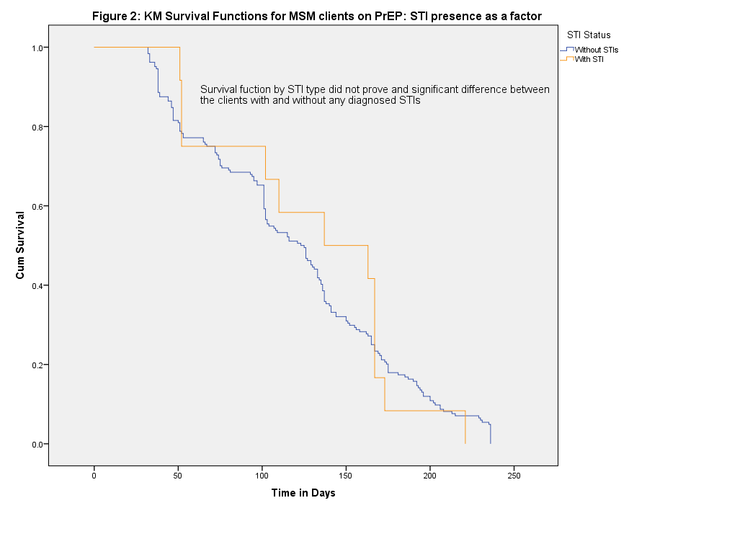
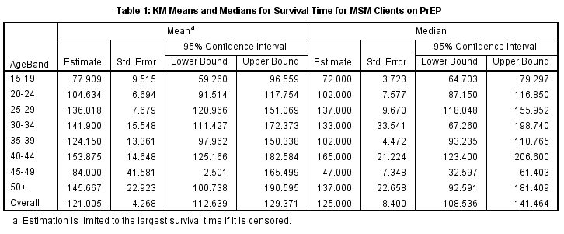
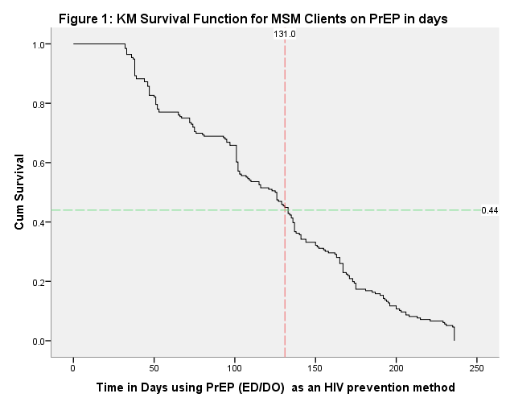

Estimating PrEP usage amongst MSM using probabilistic techniques – (Kaplan Meier Method), a retrospective cohort analysis 2022-2023, Harare, Zimbabwe.
Authors: Casper Hera¹, Precious Moyo¹, Charlton Muchemwa¹, Shamiso Nyakuwa¹, Joseph Murungu¹, Imelda Mahaka¹
1Pangaea Zimbabwe Harare, Zimbabwe
Background
Men who have sex with men (MSM) and other key populations are at a significantly higher risk of acquiring HIV compared to the general population. Therefore, ensuring effective uptake and consistent usage of HIV prevention methods, such as PrEP, among MSM is critical for reducing new infections and achieving epidemic control within this subpopulation. However, continuation of health services for MSM is often hindered by structural barriers, including hostile attitudes from service providers, criminalization, stigmatization, and discrimination faced by MSM in public health facilities in Zimbabwe.
To address these challenges, Pangaea Zimbabwe (PZ) implemented a prospective cohort study to evaluate the feasibility and acceptability of event-driven PrEP (ED-PrEP) from October 2022 to May 2023. The objective of this analysis was to estimate the number of days MSM clients would use PrEP, employing scientific methods to obtain accurate data and insights regarding adherence within this specific population
Methods:
A probabilistic method based on the Kaplan-Meier (KM) estimator was employed to retrospectively assess the number of days a unique individual would be covered by either event-driven or daily oral PrEP in a cohort of 196 MSM clients participating in a feasibility and acceptability study for event-driven PrEP (ED-PrEP). In this analysis, an "event" was defined as the discontinuation of PrEP as an HIV prevention strategy. Clients who continued PrEP beyond the study period were right-censored to account for their ongoing use. To evaluate differences in survival times based on various factors, Cox's proportional hazards model was utilized. This approach allowed for the examination of how different variables influenced the duration of PrEP coverage among the participants in the study.
Results
The mean estimated survival time for MSM clients using PrEP is 121 days, indicating that, on average, individuals adhere to the medication for just over four months. This finding, with a 95% confidence interval of [112; 129], underscores the importance of sustained PrEP usage for effective HIV prevention (Table 1).
The study revealed that the presence of sexually transmitted infections (STIs) did not significantly impact estimated survival times for MSM clients on PrEP. (Figure 2).
Age was identified as a significant factor influencing survival time, with clients aged 40-44 exhibiting the longest mean survival time of 154 days, while those aged 15-19 had a much shorter mean survival time of only 78 days.
Conclusion
Overall, recognizing age as a significant factor in PrEP adherence can inform healthcare providers and policymakers in designing targeted educational programs to improve adherence rates, particularly among younger MSM populations. However, to gain a deeper understanding of the survival outcomes for each client, additional data on clinical characteristics is necessary to further understanding of factors that might influence adherence and effectiveness, enabling more personalized and effective PrEP.

