Slide 1


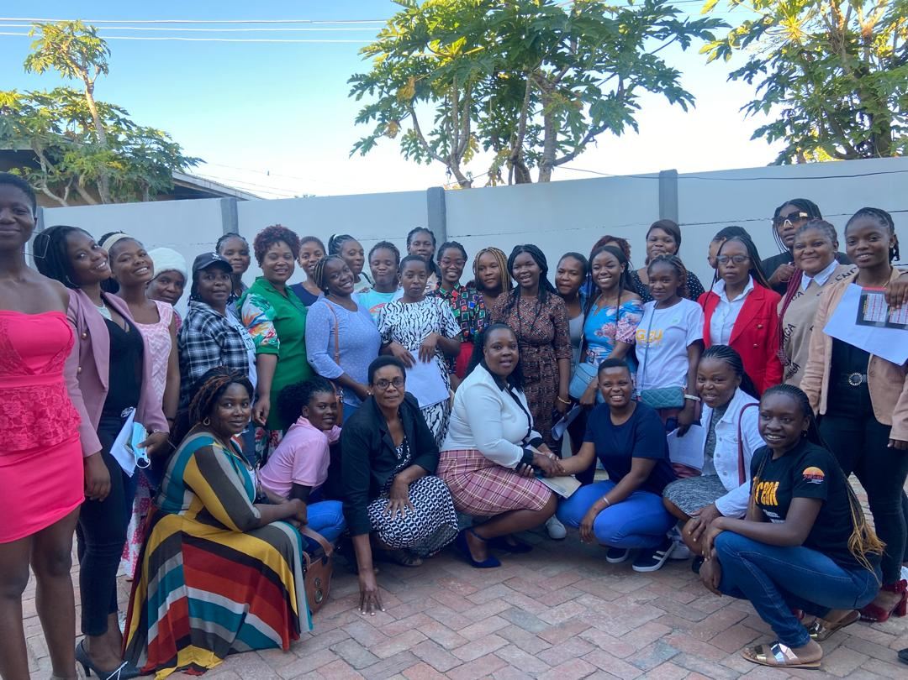
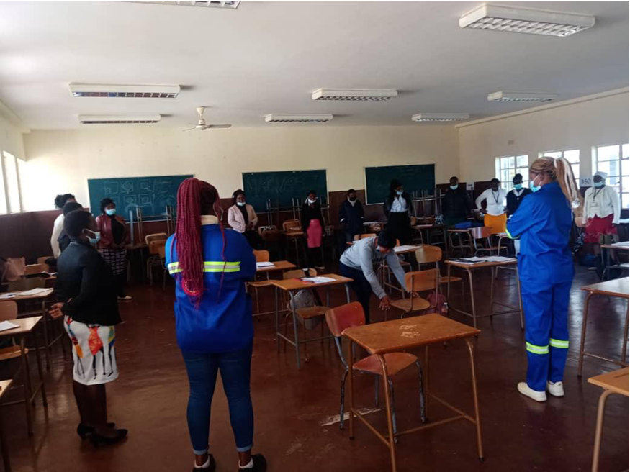
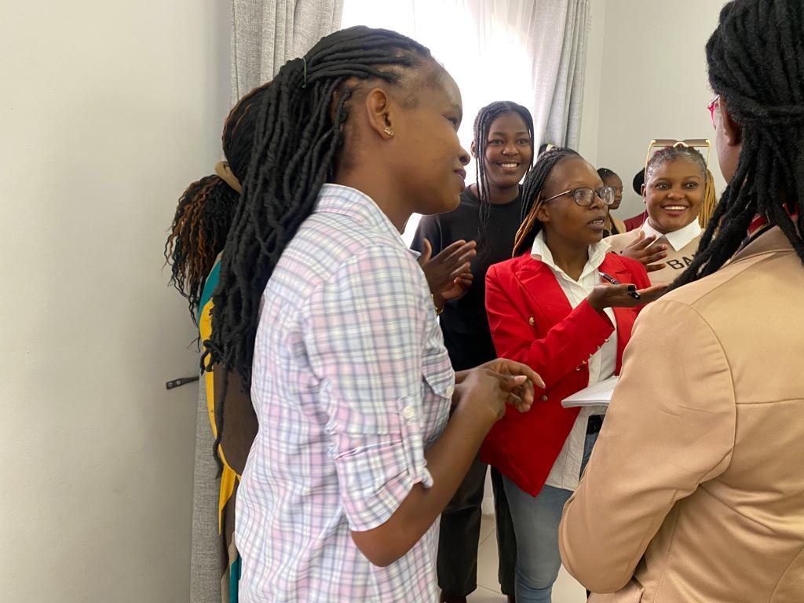






Integrated peer driven advocacy for HIV prevention in Tertiary Institutions
EPD110
Authors: Cleopatra Mpaso¹, Imelda Mahaka¹, Definate Nhamo¹, Joseph Murungu¹, Barbra Ncube¹, Navita Jain², Breanne Lievense²
Affiliation: 1: Pangaea Zimbabwe, Harare, Zimbabwe 2: AVAC, USA
Background
Results
Adolescent girls and young women (AGYW) aged 15–24 years, experience higher HIV incidence (0.54%) compared to their male (0.20%) counterparts in Zimbabwe. Although these young people, particularly AGYW are at high risk of HIV, they have limited access to services and information. This has the potential to increase the number of new HIV cases given that tertiary institutions have a large pool of adolescents and young people at high risk of HIV, STIs and unintended pregnancy. To this end, Pangea Zimbabwe implemented a peer led intervention in seven tertiary institutions with the aim to expand access to HIV prevention options among AGYW in tertiary institutions.
From March to November 2023 the champions reported that 911 AGYW were reached with information and 325 were initiated on oral PrEP (pre-exposure prophylaxis).
Oral PrEP services increased from 2/7 tertiary institutions in 2022 to 5/7 tertiary institutions. Champions installed local-level (institution-based) structures for HIV prevention advocacy. Some formed committees to train students whilst some elected intermediaries who collected HIV prevention supplies on behalf of others.
2024 Trained HIV Prevention Champions from 7 tertiary institutions and their College authorities
Trained HIV Prevention Champions familiarizing with Oral Pre-exposure prophylaxis
Methods
Conclusion and Recommendations
In 2022 and 2023, 35 prevention champions in seven tertiary institutions (5 per institution) were purposively sampled targeting those within provinces with higher incidence and representing most provinces with high HIV incidence in Zimbabwe. The Hive model assumes that peers act as catalysts for change since they have a lived understanding of situations faced. Two institutions were purposively assigned to the HIVE method. Five prevention champions mobilized and introduced new beneficiaries (24 AGYW) and cascaded SRH and HIV prevention knowledge. In the remaining five institutions, champions disseminated information to their peers using already existing college structures. Increased HIV prevention awareness and access was assessed by an increase in prevention options offered in the institution.
Peer driven initiatives pinpoint the root causes of limited use of HIV prevention methods in tertiary institutions. They also have an impact of increasing awareness, knowledge and destigmatization. Tertiary institutions play a vital role as providers of PrEP services and in offering youth-friendly services. Hence this should be built upon to improve tertiary institution HIV prevention service delivery.
2023 Trained HIV Prevention Champions from 7 tertiary institutions and their College authorities
HIV Prevention Champions HIVES
This work was supported by the Coalition to Accelerate and Support Prevention Research (CASPR), made possible by the generous support of the American people through the US President’s Emergency Plan for AIDS Relief (PEPFAR) and the US Agency for International Development (USAID). The contents do not necessarily reflect the views of PEPFAR, USAID or the United States Government.

