Slide 1
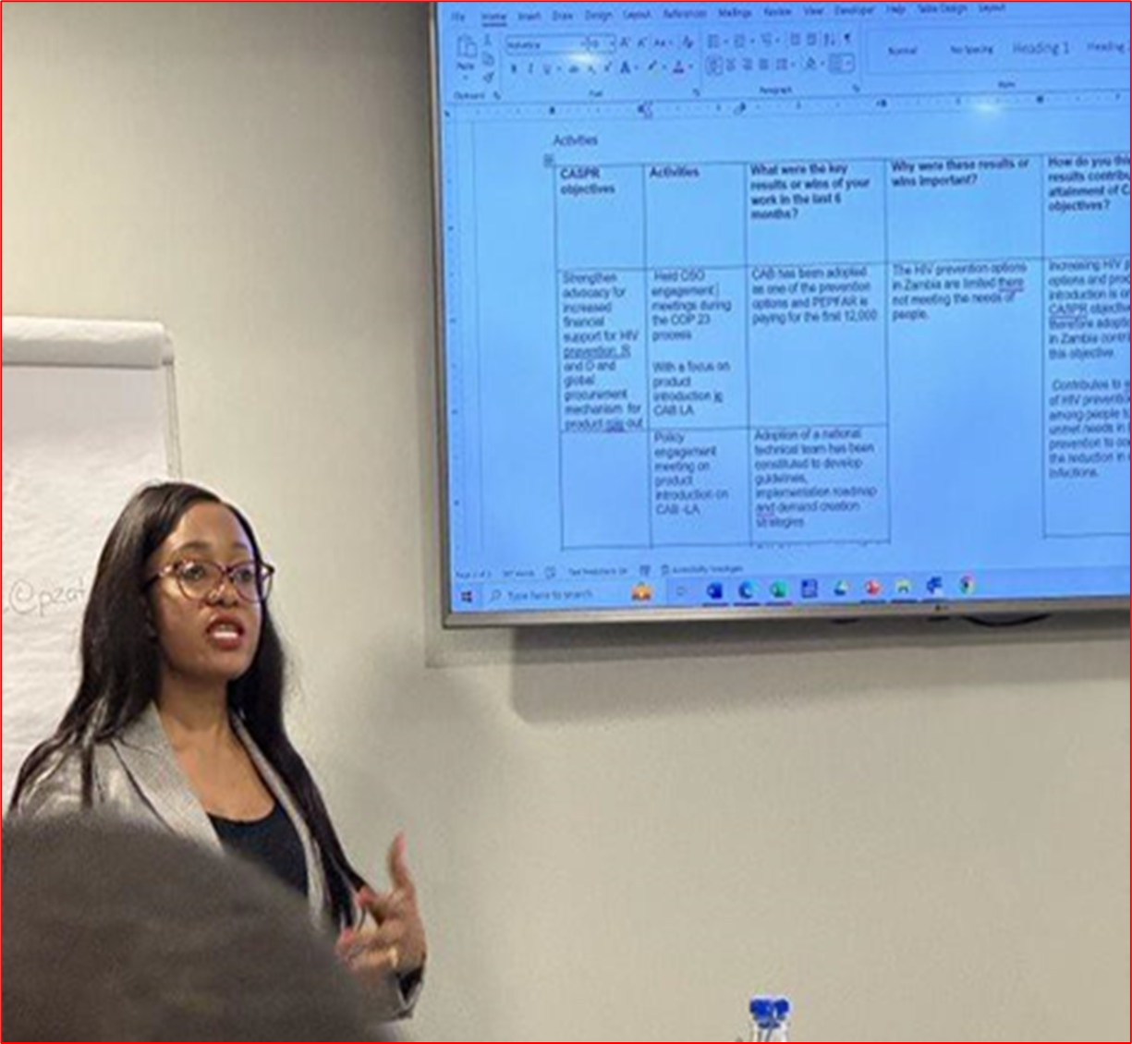

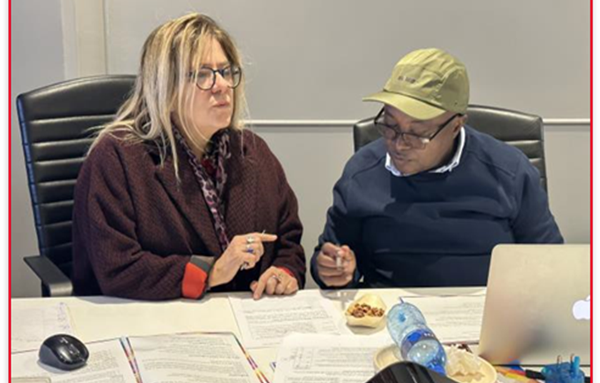
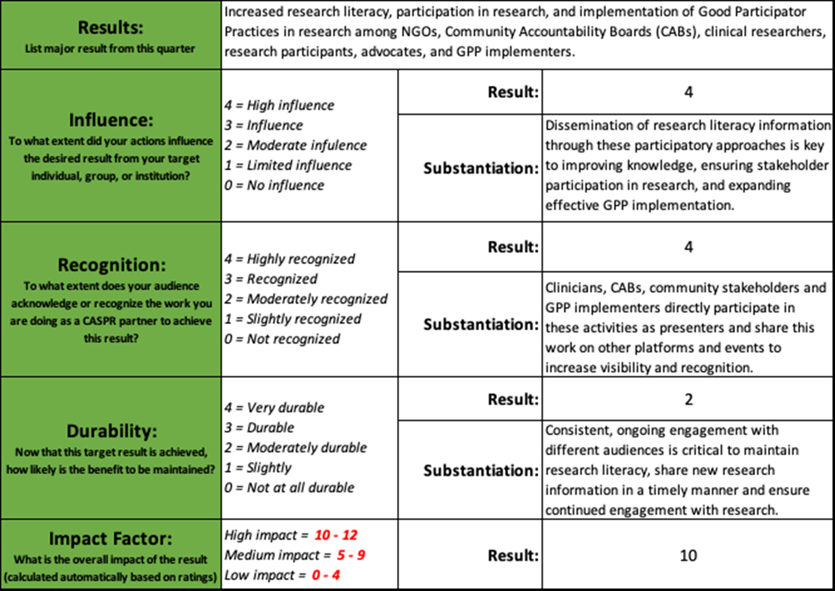
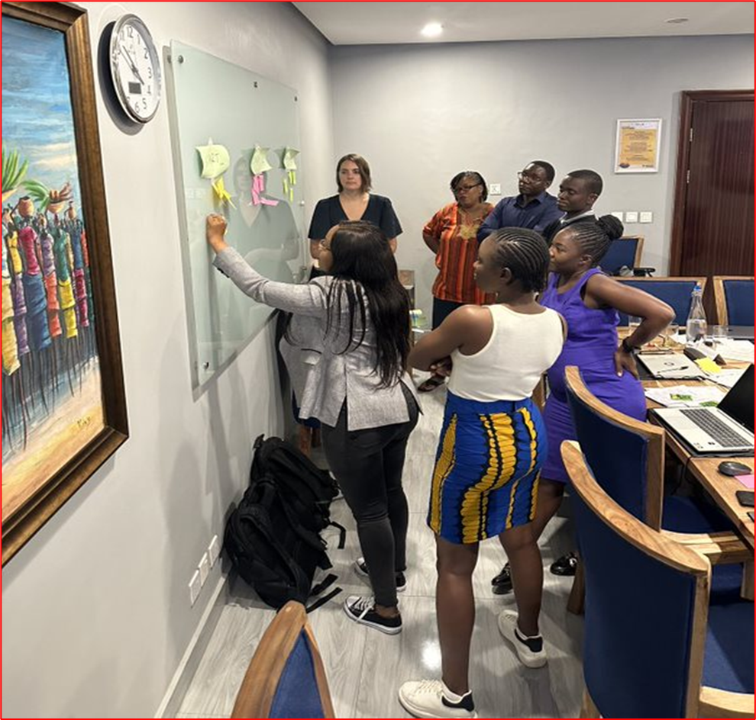
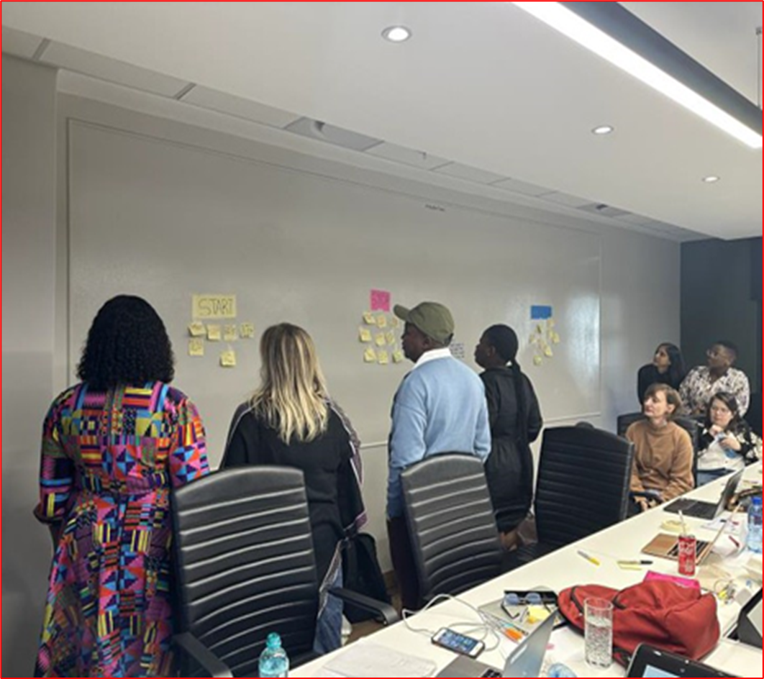




Evaluate and Elevate: Leveraging the CASPR Outcomes Assessment Tool (COAT) to Enhance Advocacy Impact
Authors: Princess R Mharire¹, Barbra Ncube¹, Grace Tetteh², Roberta Sutton²
Affiliation: 1: Pangaea Zimbabwe, Harare, Zimbabwe 2: AVAC, USA
Issues
Advancing community-centered HIV prevention research relies on strong, evidence-based advocacy by coalitions and civil society representing community demands.
It can be challenging to identify which strategies are successful amongst many stakeholders in a complex research and policy environment.
An effective approach to assess intended and unintended outcomes and establish corrective actions to strengthen future advocacy work is critical to evidence-based advocacy.
Lessons Learned
Brainstorming results helps to evaluate impact over time, and continuously learn about effective strategies.
The COAT allows advocates to refine their approach, enhance their impact, and ultimately drive meaningful change in their respective spheres of influence to be told.
The COAT enables advocates to concentrate on outcomes rather than solely engaging in activities making it a valuable tool to gauge impact and create a roadmap of successful strategies and areas for improvement.
The COAT encourages shared learning across the coalition, strengthening the collective success of CASPR partners. Impactful results and lessons learned are then shared with the Coalition, supporting the strengthening of our collective work. The COAT has documented successful advocacy, including the effectiveness of research literacy efforts to strengthen community and stakeholder engagement during clinical trials.
Description
The CASPR Outcomes Assessment Tool (COAT) is a unique tool designed to help advocates quantitatively assess results, analyze the impact of their work, and use that evidence for decision-making and planning.
The next step is Brainstorming. This phase in the COAT process enables team members to compile a list of the organization's accomplishments. Questions 1-5 (below) facilitate thinking and reflecting on the results from the past six months, while questions 6-7 assist in prioritizing and rating these results.
1. What were the key results or wins of your work in the last 6 months?
2. Why were these results or wins important?
3. Which activities helped you achieve these results?
4. How do you think these results contributed to achieving CASPR objectives?
5. Do you have any areas of your work or results that need improvement? What action(s) would you take to strengthen the result?
6. Considering the definitions of the 3 pillars, would you rate each of your key results from question 1 as having high or low influence, durability, and/or recognition?
7. Which results require further strengthening? What were some of the setback outcomes that may have stalled or blocked the achievement of your CASPR goals?
Advocates connect outcomes to key activities/strategies and evaluate evidence of their contributions to the result.
For a single result, quantitative ratings are given for 3 categories: influence, recognition, and durability. Each rating is substantiated with qualitative evidence, and an overall impact score is calculated; scores range from 0 (low impact) to 12 (high impact).
In the Summary Action Plan, advocates devise follow-up actions for low-impact outcomes to strengthen results and adjust tactics. The completed COAT report showcases attained outcomes, outlines adjustment plans, and summarizes the collective value and influence on the HIV Prevention research agenda.
Fig 3: Participants collectively identify and share the results of their advocacy work as part of the COAT Completion Exercise
Next Steps
Ongoing use of the tool allows advocates to refine and strengthen advocacy for low-impact results, and disseminate lessons learned from high-impact results.
The COAT is useful to other advocacy and civil society organizations interested in assessing their impact.
Using completed COATs from individual CASPR partners allows a cohesive story of coalition-wide outcomes.
Fig 4: Participants collectively discuss ways of maintaining positive results and learning from those that did not do so well.
Fig 1: Summary of completed COAT results.
This work was supported by the Coalition to Accelerate and Support Prevention Research (CASPR), made possible by the generous support of the American people through the US President’s Emergency Plan for AIDS Relief (PEPFAR) and the US Agency for International Development (USAID). The contents do not necessarily reflect the views of PEPFAR, USAID or the United States Government.

