Slide 1


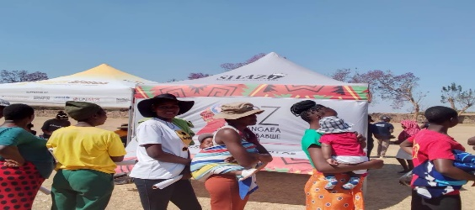
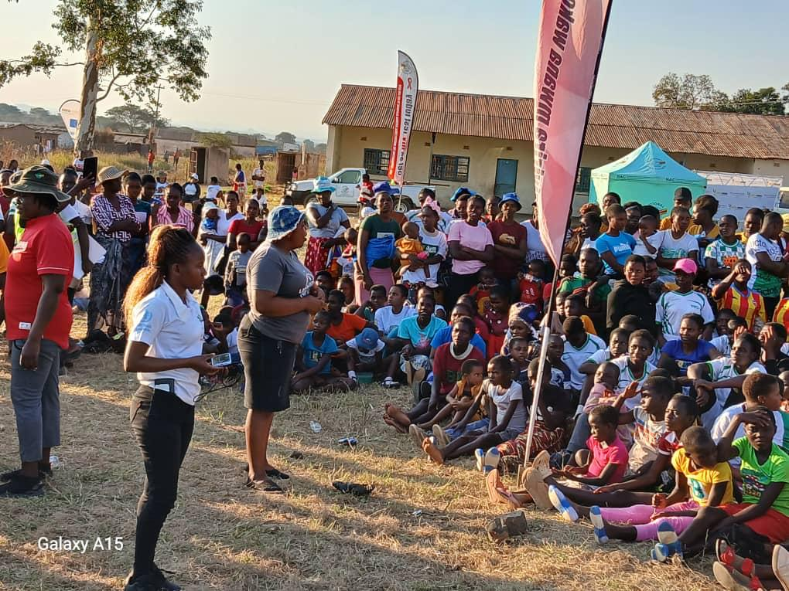
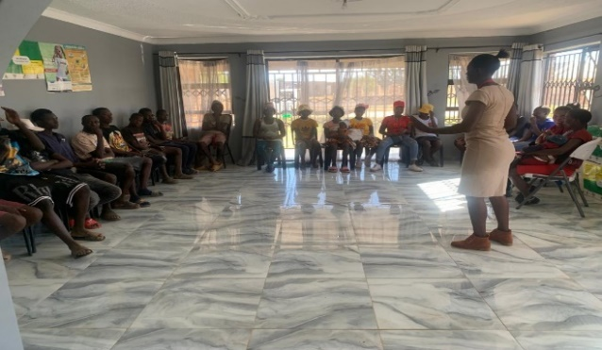




52
Improving access to SRH and HIV Prevention services through a co-created safe-space model in rural Zimbabwe.
Manyanga. R¹, Murungu J. ¹, Makura C. ¹ ,Mahaka Imelda ¹
¹ Pangaea Zimbabwe
rmanyanga@pangaeazw.org
Background
Methods
Zimbabwe achieved HIV epidemic control and the 95-95-95 targets. However, geographic areas and sub-population groups such as adolescents and young women (AGYW) (15-24) are lagging. Pangea Zimbabwe (PZ) introduced a Safe-Spaces Model to improve access to comprehensive youth-friendly HIV prevention and SRH services among adolescents and young people in their diversity in the Mazowe district.
Safe-space hub creation informed by consultations, insights, and preferences from AGYW. 9 Combination HIV Prevention (CHIP) Champions capacitated to provide peer-to-peer support through conducting community dialogues, literacy sessions, referrals, and follow-ups. Service uptake and client experiences measured through surveys and standardised Ministry of Health and Child Care (MOHCC) tools. Model refined from feedback from the young people.
Limited access to youth-friendly service provision
Poverty
2
4
1
Early sexual debut
3
Limited SRH knowledge
Figure 1: Key drivers of the epidemic in this mining, farming community
Image 1: AGYW in line to receive HIV Prevention/SRH services at a Mazowe Outreach
Lessons Learnt
Co-creation of the service package and the service delivery model fosters buy-in and uptake of services such as PrEP and family planning in an integrated, secure, and comfortable manner. Peer-to-peer models are effective in improving performance across the continuum of care. .
Image 2: CHIIP Champions conducting an outreach with participants from the Mazowe community
Conclusion
Co-created models of delivery that are based on the preferences of AGYW would increase uptake, effective use of SRH and HIV prevention including the new biomedical HIV prevention and reduce stigma. Scaling up such models requires context-specific adaptations.
Image 3: CHIIP Champion conducting a literacy session with young people mobilized from the community in Mazowe

